Slide 1

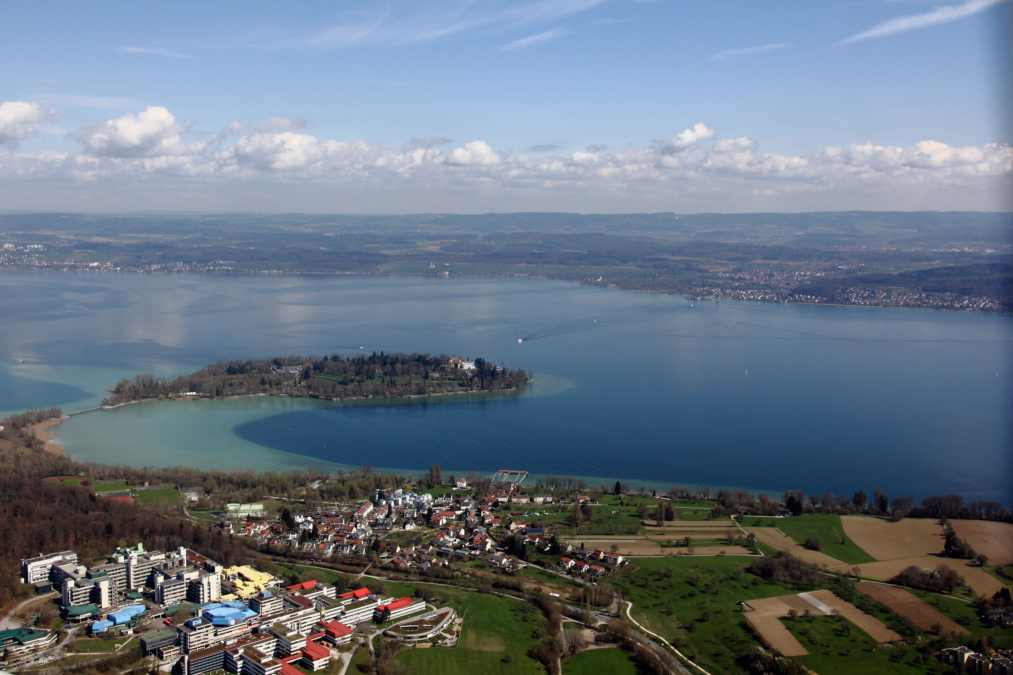
Universität Konstanz
Study Abroad
with us!
Melanie Hochstätter, M.A.
Erasmus+ Coordinator, Faculty of Humanities, University of Konstanz

Slide 2
Overview
Introduction
The city of Konstanz
The University of Konstanz
Information for exchange students
Further information on individual departments:
  Literature, Art and Media Studies
  Linguistics
  Politics and Public Administration
  Economics

Slide 3

Konstanz
3

Slide 4
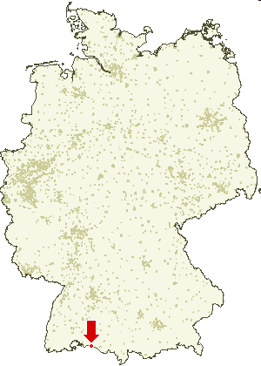
Where is Konstanz?
4

Slide 5
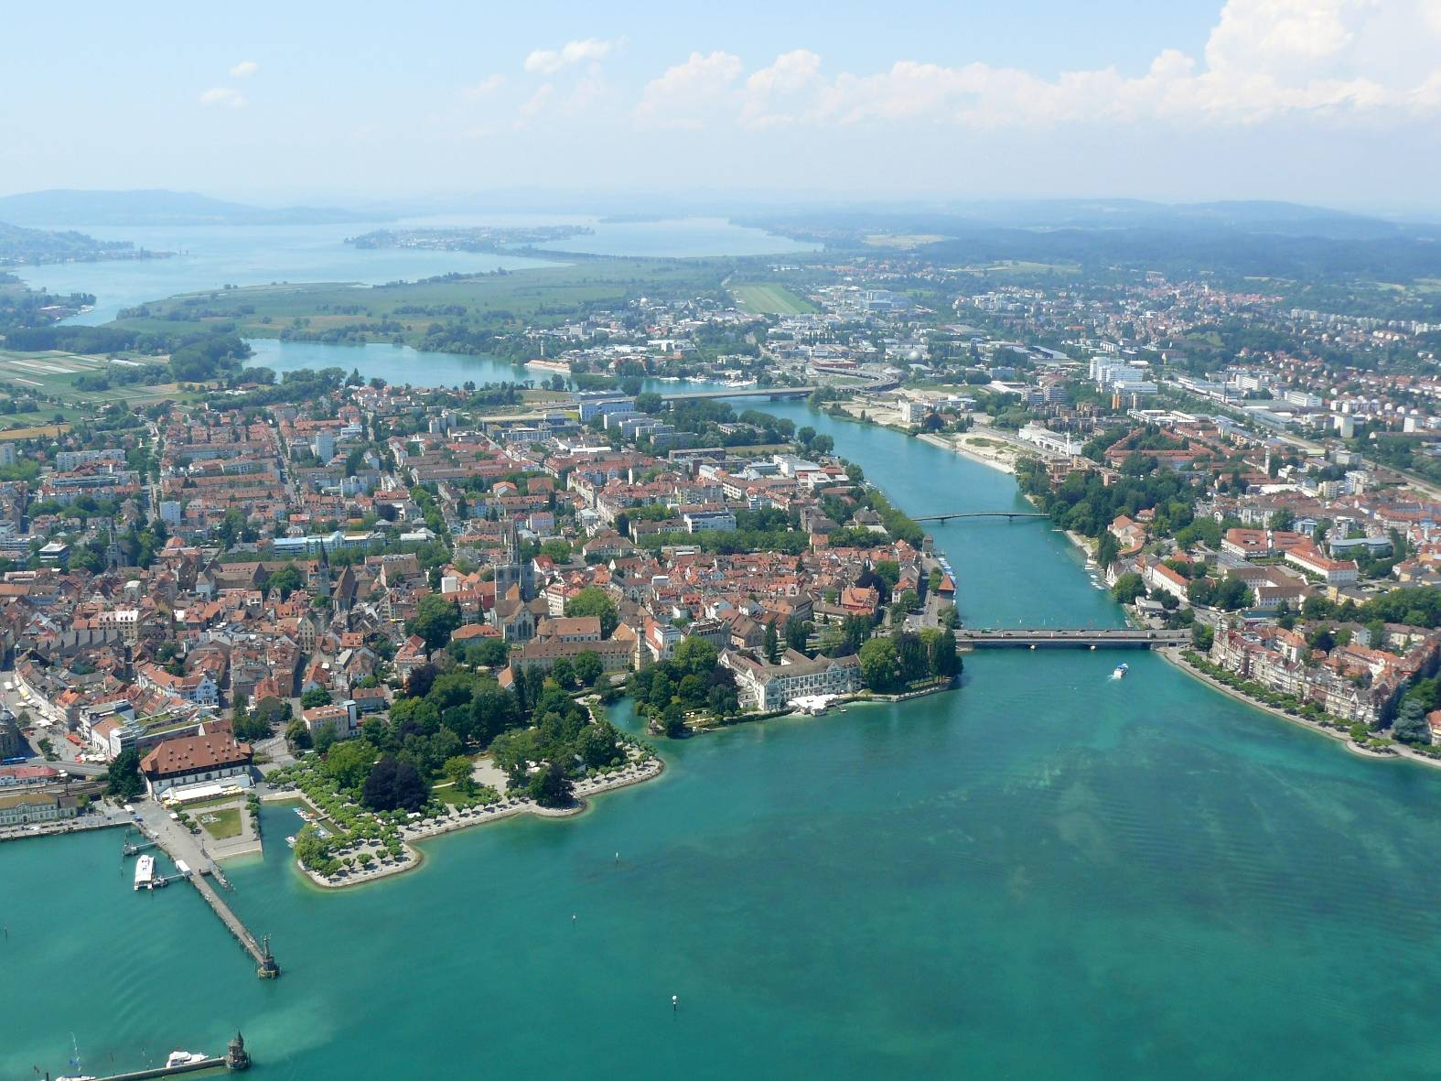
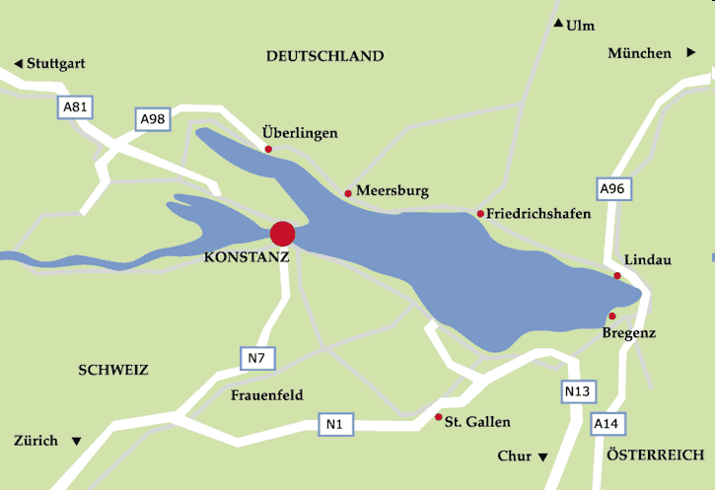



Where is Konstanz?
5

Slide 6
Where is Konstanz?
Here!
6

Slide 7
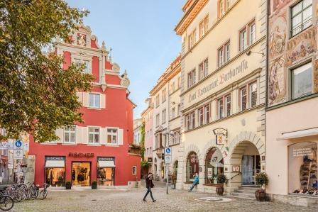


Living in Konstanz
7
Notes:
7

Slide 8
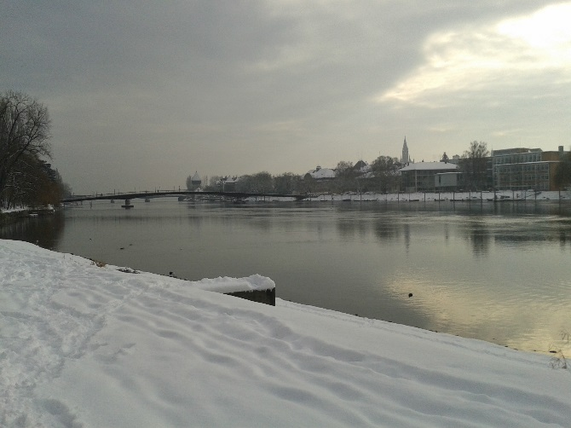

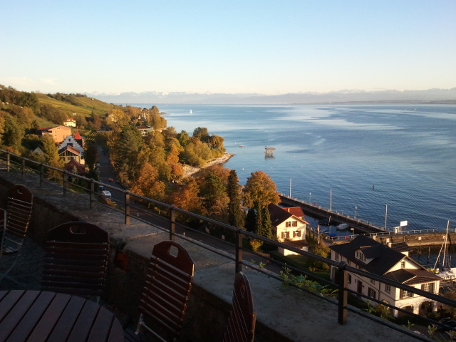
Living in Konstanz
    mid-sized historic town with a population of roughly 86.000
    11.000 students at the university and 4.800 at the University of Applied Sciences
    situated in a beautiful environment at Lake Constance and close to the Alps,
    a region in Germany with vineyards and orchards
    great outdoor sports opportunities (lake and mountains)
    bordering on Switzerland and close to Austria
    (Konstanz is an ideal location to reach neighbouring countries)
    bike friendly city, everything is reachable by bike; good public transport system
    diverse pub scene
    safe place to stay
8
Notes:
8

Slide 9
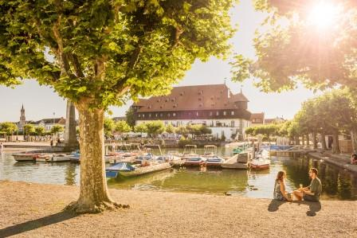
Living in Konstanz
9
Notes:
9

Slide 10
Universität Konstanz
10

Slide 11
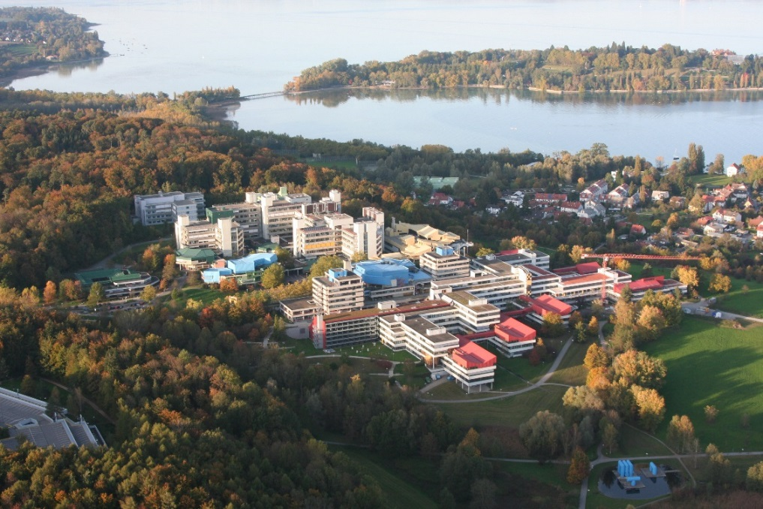
The University of Konstanz – A young campus university
Konstanz is one of the “younger” German Universities, funded in 1966 as Reformuniversität (reform University), its architectural make-up reflecting the founding principles and internal organisation:
    A campus university with a
    departmental structure and a flat hierarchy,
    An interdisciplinary approach to research, manifested in a campus university
    Efficient centralised research
    and administrative services
11

Slide 12
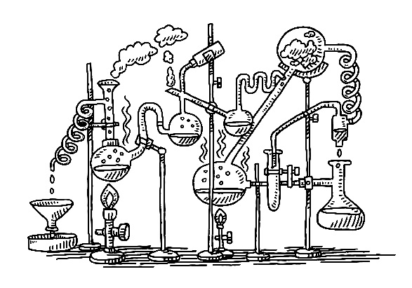


Academic Faculties and Departments
Faculty of Science
    Mathematics and Statistics, Computer and Information Science
    Physics
    Chemistry
    Biology
Faculty of Humanities
    Philosophy
    History and Sociology with Sport Science
    (and Empirical Educational Research)
    Literature, with Art History and Media Studies
    Linguistics
Faculty of Politics, Law and Economics
    Politics and Public Administration
    School of Law
    Economics
12

Slide 13

Degree structure in the Faculty of Humanities
BA-level
Usually major and minor (B.Ed. major plus major),
incorporating an internship of 8 weeks,
transferable and language skills
Compulsory coursework in year one,
year 2 and 3 characterized by individual choice
= optional courses in modules* of the degrees
MA-Level
Usually major (M.Ed. major plus major),
incorporating transferable and language skills
Compulsory coursework in year/semester one,
year 2 characterized by individual choice = optional courses in modules* of the degrees
*in German “Modul” ≠ module
13
Notes:
13

Slide 14

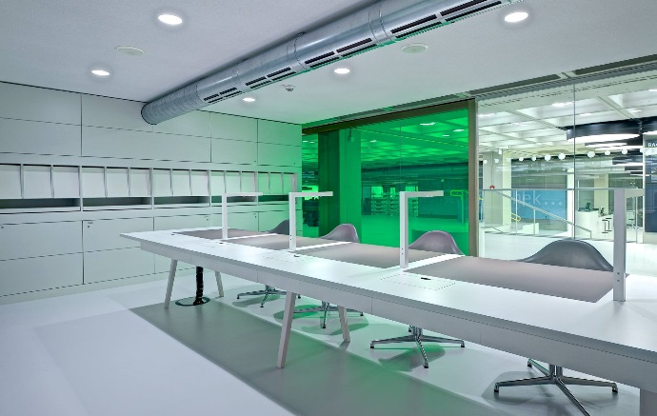
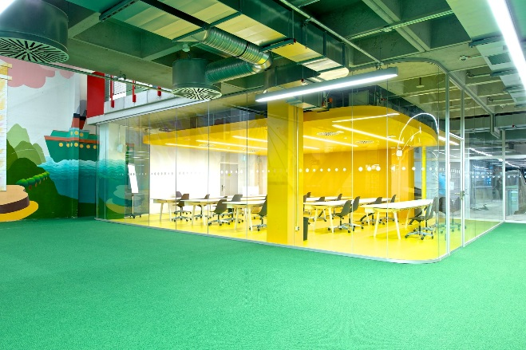
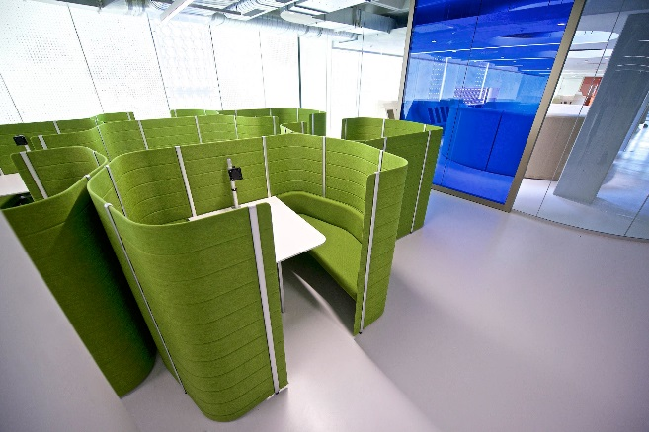
The Library of the University of Konstanz
Open 24/7! The Library was awarded “Library of the Year” in 2010.
  it offers great support services for students and researchers (inter-library loan, KonDoc, subito etc.) and invites to go on a stroll along the shelves
  reopened September 2015 after extensive renovation!
  study spaces for single or group work
Over 2 million volumes and more than 50.000 e-journals and e-books – read them whenever you want!
14

Slide 15
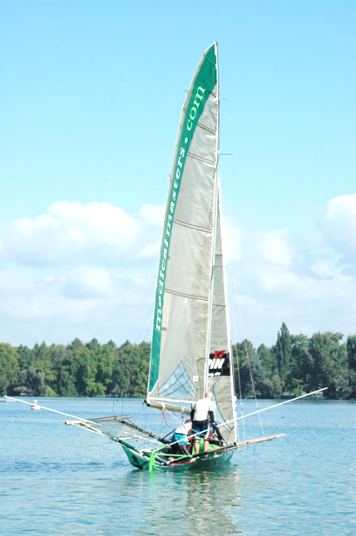
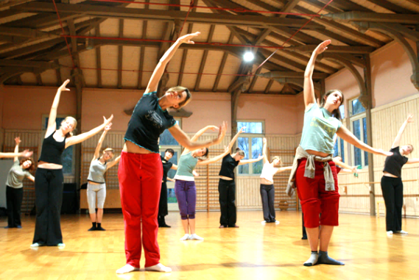
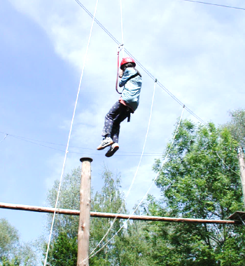
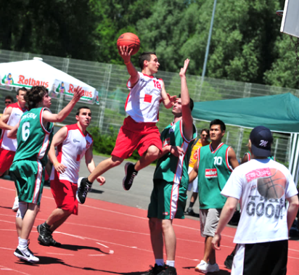
University Sports
A broad athletics programme with a course for everyone!
The university’s location near Lake Constance and the Alps provides optimal conditions for water sports, skiing, climbing, mountain biking and hiking aside from the more common sports courses in football, basketball, tennis, (modern) dance and the like.
15

Slide 16
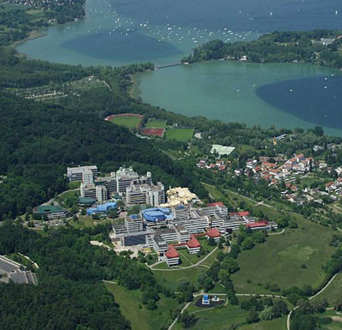
University Sports
A broad athletics programme with a course for everyone!
The university’s location near Lake Constance and the Alps provides optimal conditions for water sports, skiing, climbing, mountain biking and hiking aside from the more common sports courses in football, basketball, tennis, (modern) dance and the like.
Team players, individualists,
professionals,
and novices are
equally welcome!
16

Slide 17

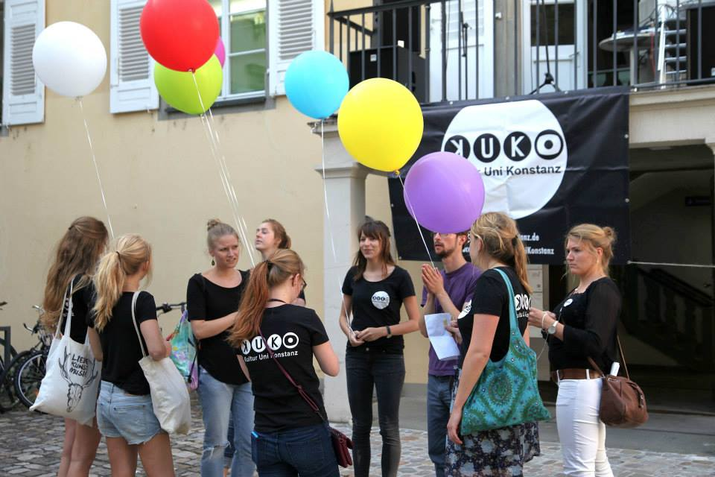

Student Activities
University Sports,
University Cinema,
Campus Radio and TV,
University Theatre, Orchestra, Choir, Big Band,
Student Associations (political, religious, social, …)
One Campus
Campus Cafeteria
Campus Café
University Restaurant
University Beach
17

Slide 18
Study Abroad in Konstanz – Why?
Academic reasons
Choose courses across Faculties and Departments
Take courses from our regular curricula
(taught in German or in English)
as well as courses designed for international students
Learn or improve your German significantly in the pre-semester intensive German language courses in March and/or September
or learn another language for free in our Language Institute
Take advantage of the course offer of the Centre for Transferable Skills:
a wide offer of courses, partly taught in English on project management, communicative, social and personal core competences, sustainability, service learning, management and Economy, media, entrepreneurship etc.
18

Slide 19
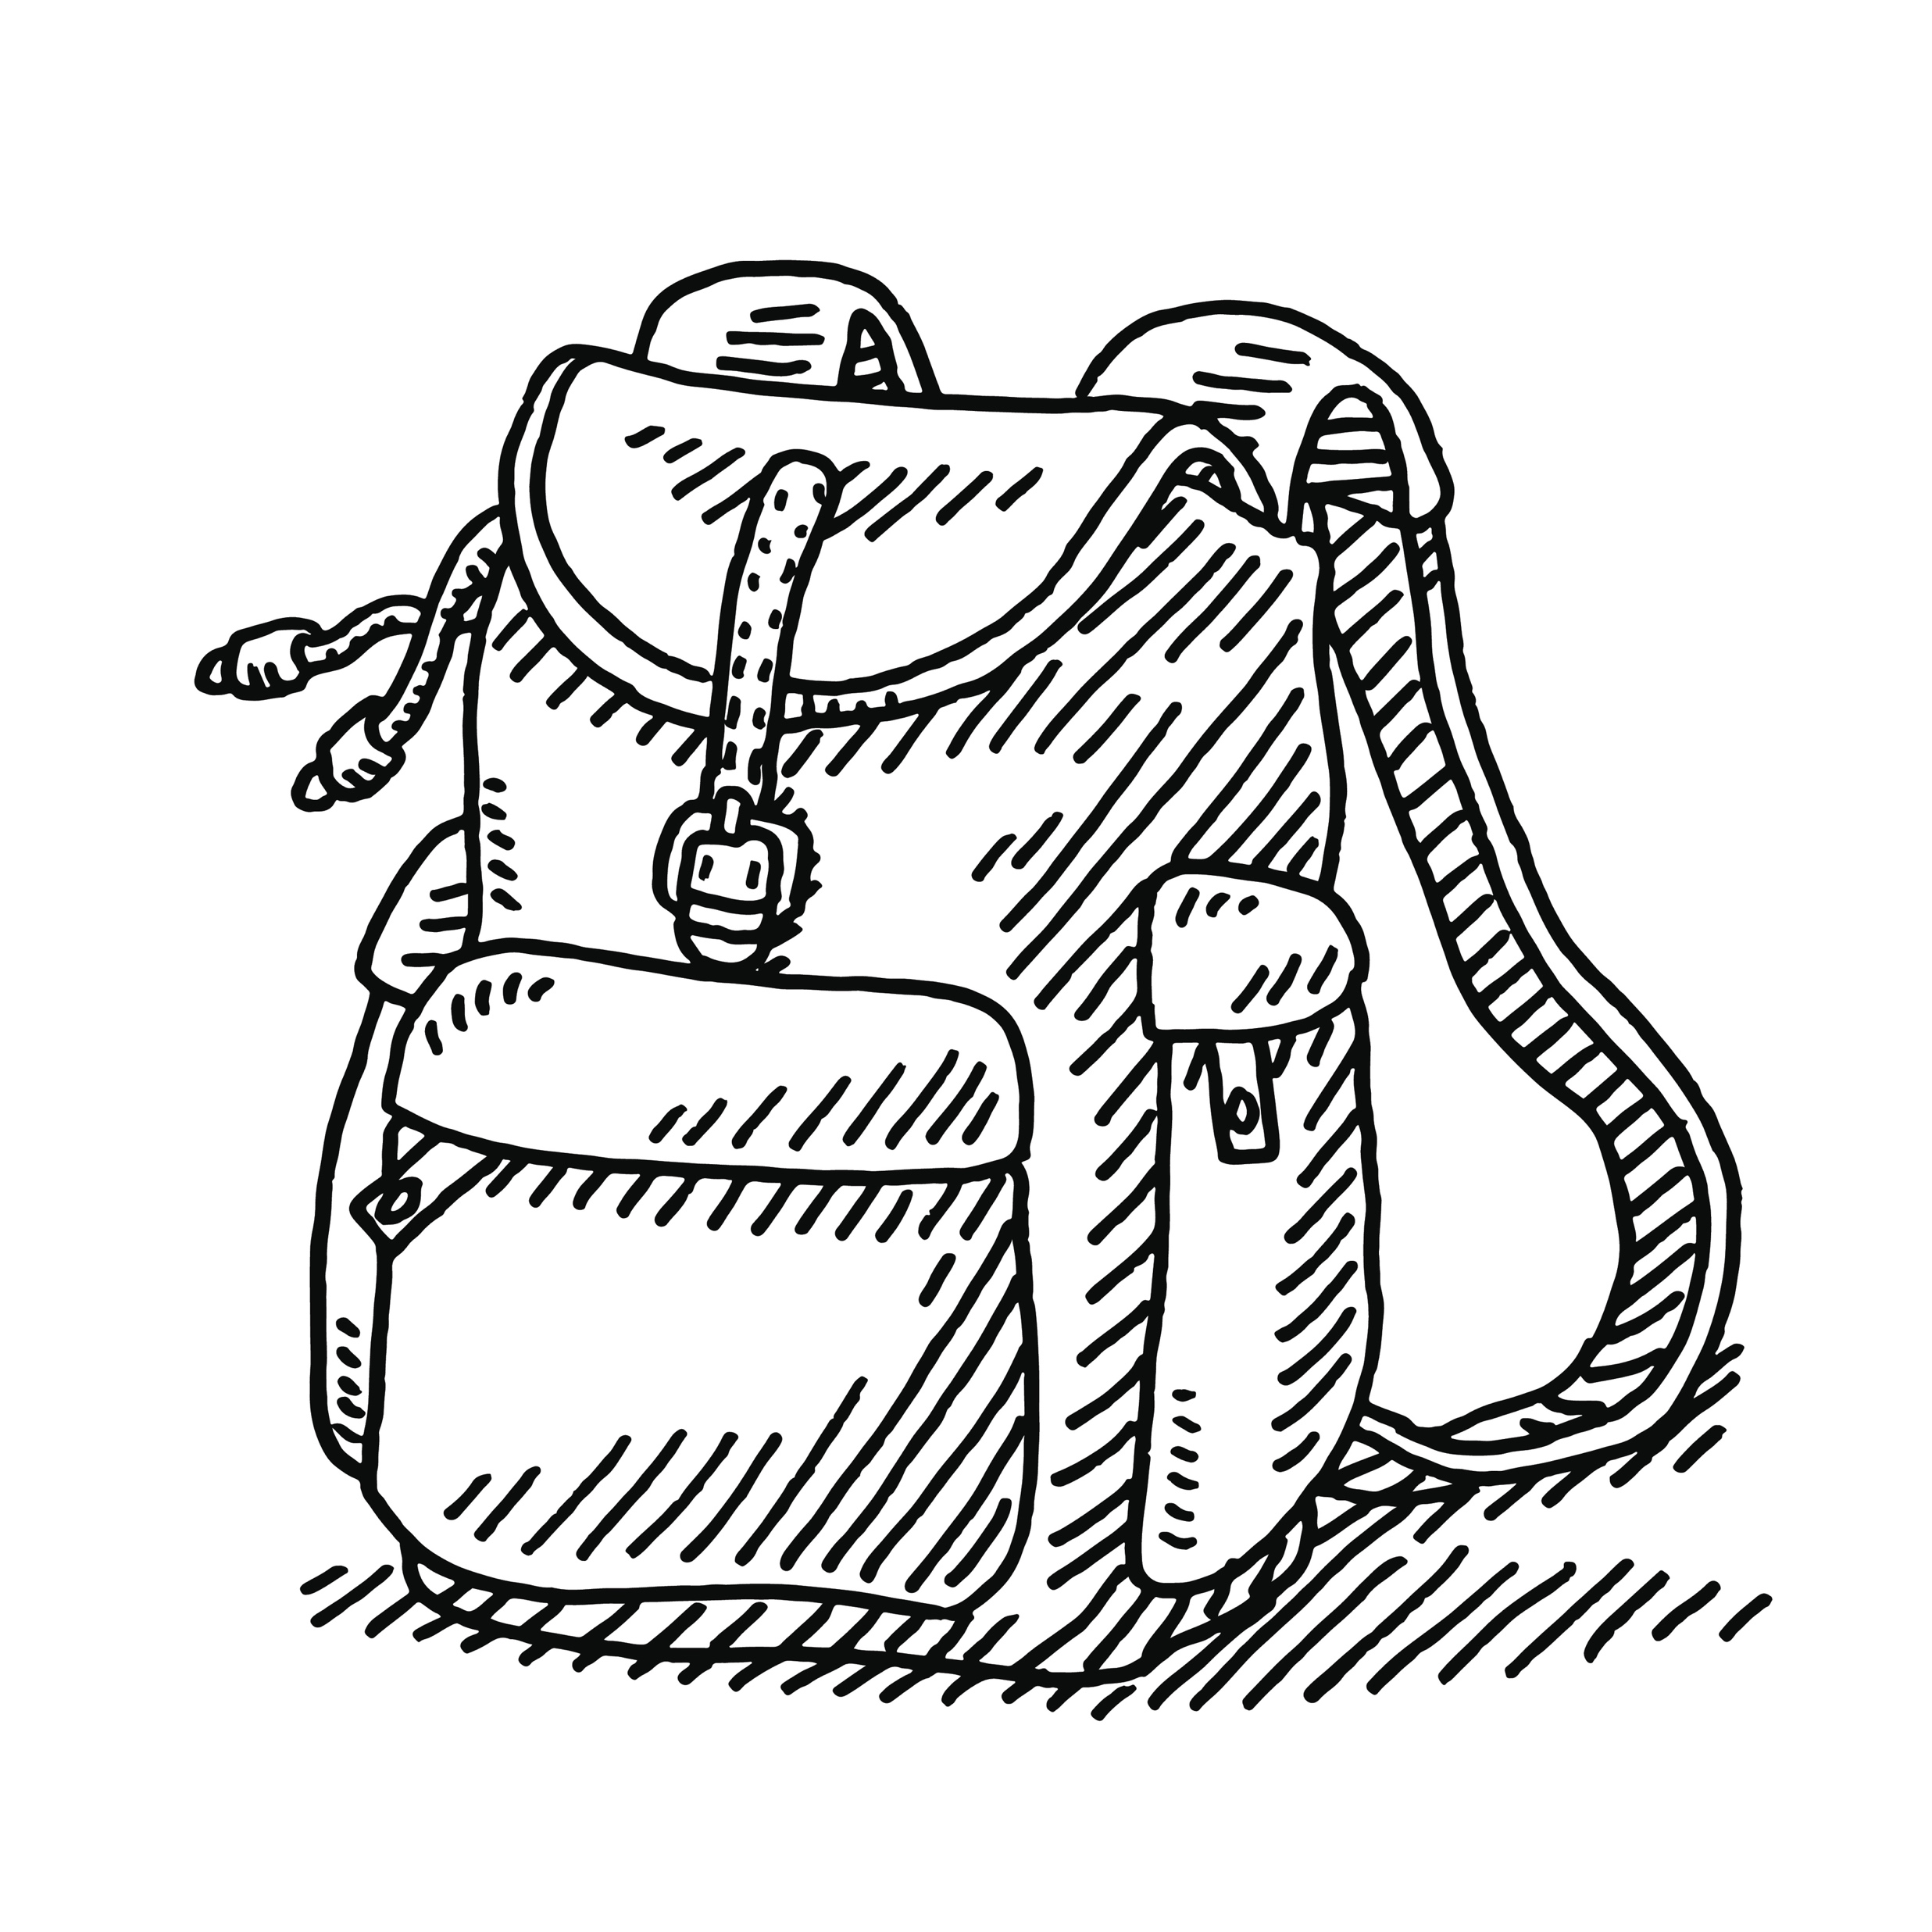
Study Abroad in Konstanz – Why?
Practical reasons
Apply for student housing
in a convenient and safe location
together with your application as exchange student*
(single rooms in shared apartments or single apartments available)
Comprehensive support by our staff before, during and after your stay
→ Konstanz is well-known for its
and…
*so far all exchange students were able to be placed in rooms by seezeit
19

Slide 20
Study Abroad in Konstanz – Why?
Practical reasons
20

Slide 21

The Academic Year
Semester system: Winter and Summer Semester
    Winter: mid / end of October until mid / end of February (lecture/teaching period)
      Exams usually in the last week of the teaching period
      Followed by a lecture-free period until mid April
    Summer: mid / end of April until mid / end of July (lecture/teaching period)
      Exams usually in the last week of the teaching period
      Followed by a lecture-free period until mid October
    Semesters are independent entities, courses usually run for one semester only
    Course catalogue (named “ZEuS”) updated every semester, reflecting the research interests of the academic staff, available in
      late February for the following summer semester (starting in mid April) and in
      late July for the following winter semester (starting in mid October)
21

Slide 22
Have a Good Start!
Orientation programmes for Internatinoal Students
Orientation programmes for International Students
    GO Konstanz!
      4-week intensive German language course on campus before the beginning of the lecture period (March and September respectively)
      groups for learners of levels A 1 – C 2
      combined with
      an Orientation programme, providing extensive support in all administrational matters connected to starting life in your new home
      Includes several cultural and fun trips (if pandemic regulations permit)
      Price: € 300 for exchange students including German course and trips
    OriPro
      1-week orientation programme shortly before the beginning of the lecture period
      information about administrational steps to be taken

Slide 23
Important terms and academic structures
We use the term „course“ generically, while the types of courses on offer vary from department to department. Terms you will come across in almost every department include:
– lecture
– seminar (introductory / advanced)
– course
When looking into our course catalogue, you will also come across the term „module“. This, however, refers to a larger entity/group of courses from a certain subject area/XYZ and NOT to an individual course. In ZEuS you would have to look through the offer within a module and select an item from a list of possible choices.
23

Slide 24
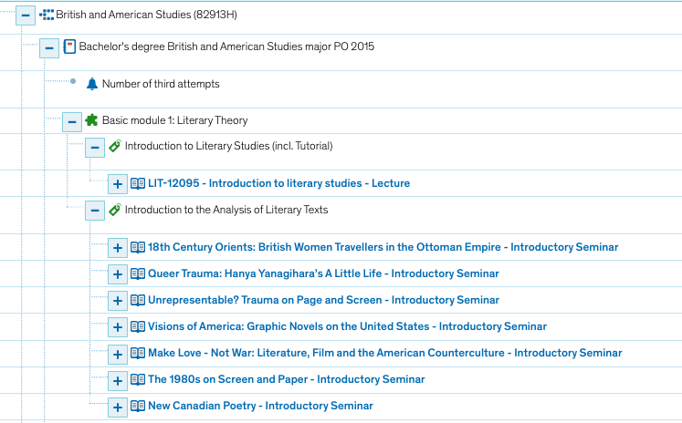
Example: Course catalogue winter semester 2021/22
Introductory seminars
24
Notes:
The course types you will come across in the Department of Literature are
– Einführung
– Proseminar
– Hauptseminar and
– colloquium (for students completing their degree in Konstanz)
Students may take Einführungen (introductions) as well as Pro- or Hauptseminare, please note that Hauptseminare are only open to advanced students of the respective philology. Students may complete courses on B.A. level with either three or 6 ECTS points, depending on the work and assessment load they complete the seminar with.
On M.A. level students completing a research-oriented paper (of about 25 pages) may complete a seminar with 9 ECTS, otherwise, depending on the word and assessment load with 3 or 6 ECTS. In ZEuS you will very often find not only one ECTS value for a course offered by the department. Lecturers will usually explain the work and assessment load for each of the ECTS values students may gain in the first meeting of class (or on an information sheet/syllabus for the course). This holds for all of the departments in the Faculty of Humanities.
24

Slide 25
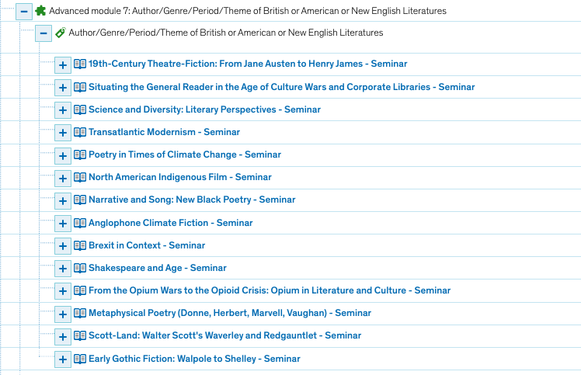
Example: Course catalogue winter semester 2021/22
Advanced seminars
Preliminary programme for
summer semester 2022:
https://www.litwiss.uni-konstanz.de/typo3temp/secure_downloads/110486/0/f16add4a00edca28eeec21ae68930752e5d74d19/Courses_in_British_and_American_Studies_Summer_2022_mit.pdf
25
Notes:
The course types you will come across in the Department of Literature are
– Einführung
– Proseminar
– Hauptseminar and
– colloquium (for students completing their degree in Konstanz)
Students may take Einführungen (introductions) as well as Pro- or Hauptseminare, please note that Hauptseminare are only open to advanced students of the respective philology. Students may complete courses on B.A. level with either three or 6 ECTS points, depending on the work and assessment load they complete the seminar with.
On M.A. level students completing a research-oriented paper (of about 25 pages) may complete a seminar with 9 ECTS, otherwise, depending on the word and assessment load with 3 or 6 ECTS. In ZEuS you will very often find not only one ECTS value for a course offered by the department. Lecturers will usually explain the work and assessment load for each of the ECTS values students may gain in the first meeting of class (or on an information sheet/syllabus for the course). This holds for all of the departments in the Faculty of Humanities.
25

Slide 26
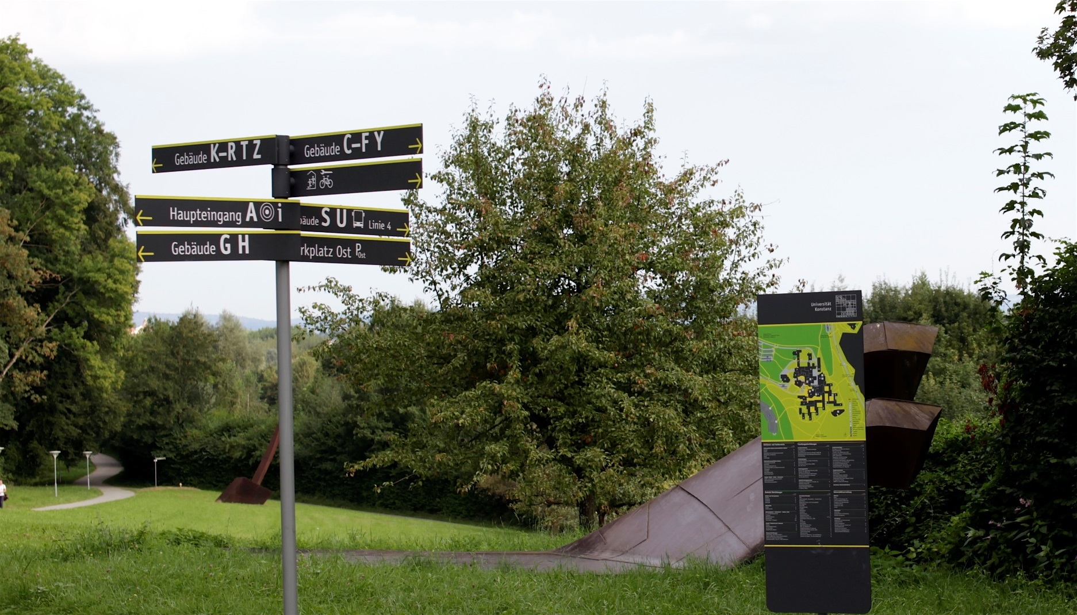
The application process for exchange students
26

Slide 27
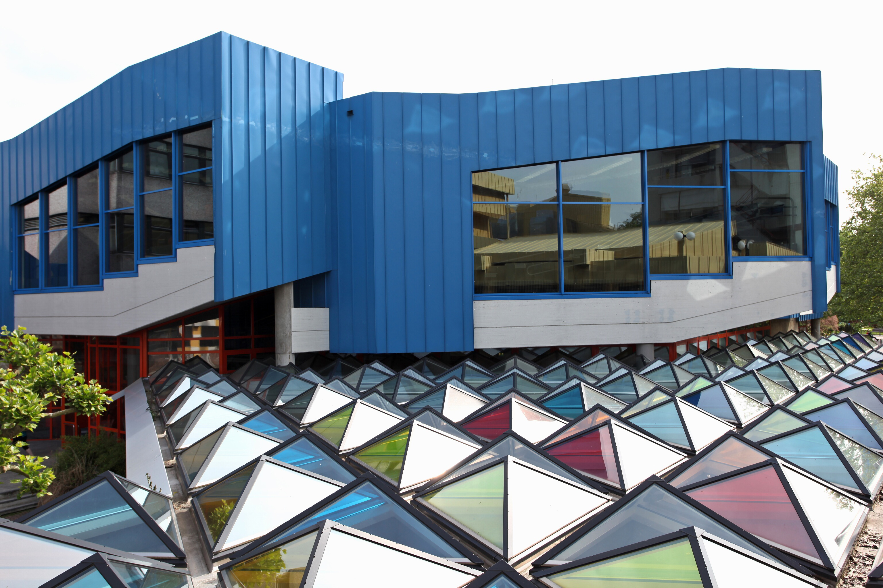
Deadlines
  15th of May
  for winter semester or full year
  15th of November for summer semester only
Study Abroad in Konstanz
Application Process for Exchange Students
Online application
  2-phase online application for admission
  Phase 1
  Application for housing and copy of bond deposit
  Registration form for Orientation
  Programme with or without
  Intensive German Programme
  Registration for Buddy Programme
  Phase 2
  Further documents for enrolment
  (proof of health insurance etc.)
27

Slide 28
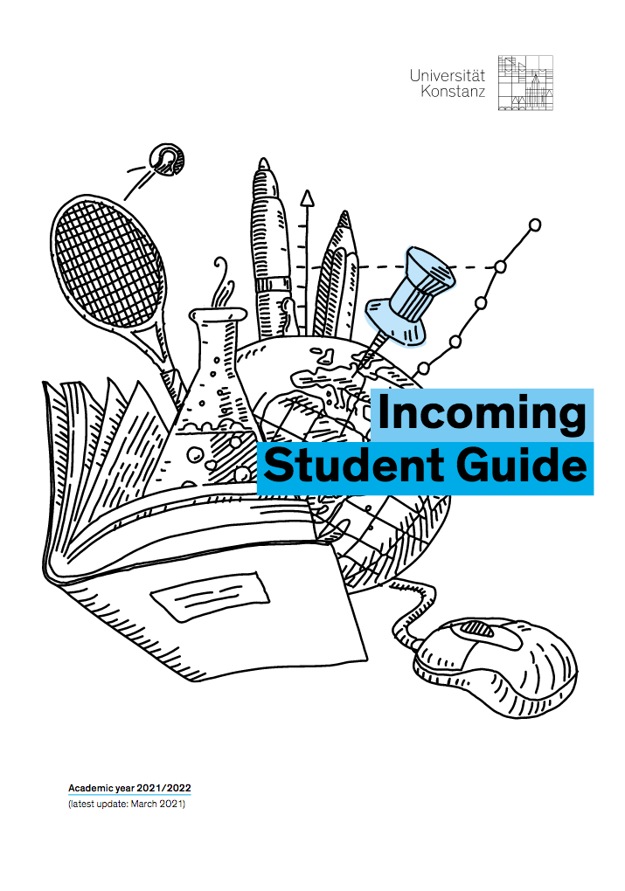
Incoming Student Guide
28

Slide 29
Information on the Departments and their Academic Offer
29
Universität Konstanz

Slide 30
Departments and Institutes Offering Courses for Philologists
Faculty of Humanities
    Philosophy
    History and Sociology with Sport Science (and Empirical Educational Research)
    Literature, with Art History and Media Studies
    Linguistics
+
The Language Institute (SLI)
Offers practical modern language courses:
currently 19 different languages on offer,
including German as a Foreign Language at levels A1-C2 (CER).
Centre for Transferable Skills (SQ)
Offers courses for BA and MA students on interdisciplinary as well as discipline-specific practical skills e.g.
project management, communicative,
social and personal core competences.
30

Slide 31
The Department of Literature, Art and Media Studies
Hosts researchers in the areas of:
(see brackets for language of instruction)
English and American Literature (English)
German Literature (German)
French, Italian, Spanish Literature (German, French, Italian, Spanish)
Latin and Greek Literature (German)
Russian / Slavic Literature (German, Russian)
Art History (with Art Technology) and Media Studies (German, English)
Major research areas are:
Literary Theory, Narratology and Cultural Studies
(Collective and Cultural Memory, Gender Issues in Literature)
Media History/Aesthetics/Theory (film, digital media, radio, concerning the singular as well as the collective systems), Image Theory.
31

Slide 32
Course types and credit values in the
Department of Literature, Art and Media Studies
B.A. level 3, 6 ECTS
M.A. level 3, 6 ECTS
9 ECTS only for a research-
oriented extensive paper
(25 pages)
ECTS-value depending on
type of assessment
(see explanation later on)
➔ Proseminar usually a good match for BA-level exchange students
➔ Hauptseminar only open to advanced students of the respective philology (BA 3rd year with research/essay writing experience or MA students)
32
Notes:
The course types you will come across in the Department of Literature are
– Einführung
– Proseminar
– Hauptseminar and
– colloquium (for students completing their degree in Konstanz)
Students may take Einführungen (introductions) as well as Pro- or Hauptseminare, please note that Hauptseminare are only open to advanced students of the respective philology. Students may complete courses on B.A. level with either three or 6 ECTS points, depending on the work and assessment load they complete the seminar with.
On M.A. level students completing a research-oriented paper (of about 25 pages) may complete a seminar with 9 ECTS, otherwise, depending on the word and assessment load with 3 or 6 ECTS. In ZEuS you will very often find not only one ECTS value for a course offered by the department. Lecturers will usually explain the work and assessment load for each of the ECTS values students may gain in the first meeting of class (or on an information sheet/syllabus for the course). This holds for all of the departments in the Faculty of Humanities.
32

Slide 33
The Department of Linguistics
Hosts researchers in the areas of:
(see brackets for language of instruction)
  English Language and Linguistics (English, German)
  German and Germanic Linguistics (German, English)
  Romance Languages and Linguistics (German, French, Italian, Spanish, Basque*, Catalan*)
  * are language and culture courses
  Multilingualism
  Speech and Language Processing
Major research areas are:
    Core areas of Linguistics
    (Phonetics, Phonology, Morphology, Syntax, Semantics, Pragmatics)
    Experimental Linguistics
    (Computational Linguistics, Neurolinguistics, Psycholinguistics and
    Language Acquisition).
33

Slide 34
The Department of Linguistics
BA Linguistics
    3 year programme
    Core Curriculum in Theoretical Linguistics, specialisation on one language (language family)
    Individual specialisation in other relevant disciplines
    (e.g. Computer Science)
34

Slide 35
Course types and credit values in the
Department of Linguistics
B.A. level 6 ECTS
M.A. level 9 ECTS
35
August 2021
Welcome to the Faculty of Humanities
Notes:
In German universities, linguists are usually scatterd throughout various language and literature departments. Following an internationally widespread model, the University of Konstanz has a separate Department of Linguistics, where linguists can join their efforts. The department provides research and teaching in general, language-specific, applied and experimental linguistics. Its chairs have areas of specialisation in English, German, Romance, and Slavic Linguistics, in Computational Linguistics, Multilingualism, Neurolinguistics, Phonetics, Phonology, and Semantics.
Courses in this department are either lectures (on introductory level) or seminars. B.A.-seminars are awarded 6 ECTS points upon successful completion, M.A.- seminars 9 ECTS points.
Lecturers will usually explain the work and assessment load for each of the ECTS values students may gain in the first meeting of class (or on an information sheet/syllabus for the course).
35

Slide 36
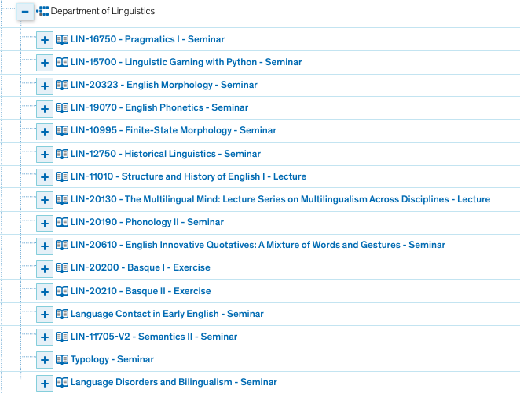
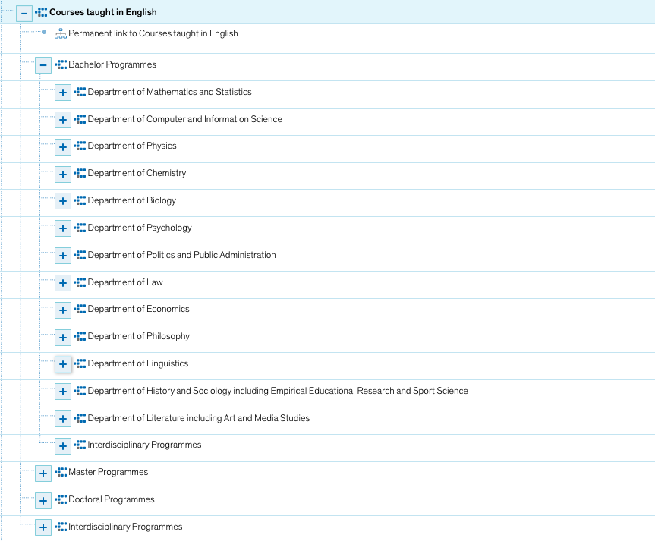
Example: Course offer winter semester 2021/22
36

Slide 37
The Department of Sports Science
Hosts researchers in the areas of:
Training and Movement Science
courses on sports and the fundamentals of human movement
Sport Psychology
courses on motivational and volitional aspects of sports and exercise
Social and Health Sciences
theoretical courses on sociological, social-psychological, health-scientific and methodological knowledge; provide solid background in research methods and ethics
Development in Early Childhood
37

Slide 38
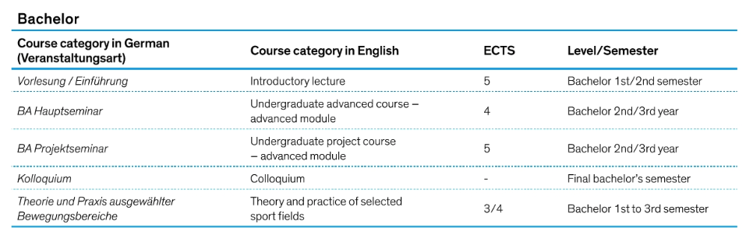
The Department of Sports Science
B.Sc. Programme
3-year programme, admission-restricted (47 per year, admission based on an entrance test) programme taught in German
Module 1-4: Methodology of Sports Science
Module 5-7 : Theory and Practice of Sport and Movement
Module 10-13: Foundations in Natural Sciences (biology, physics/mathematics)
Modul 14: Advanced seminars in Nature and Outdoor Sports (2 kinds of sport)
38

Slide 39
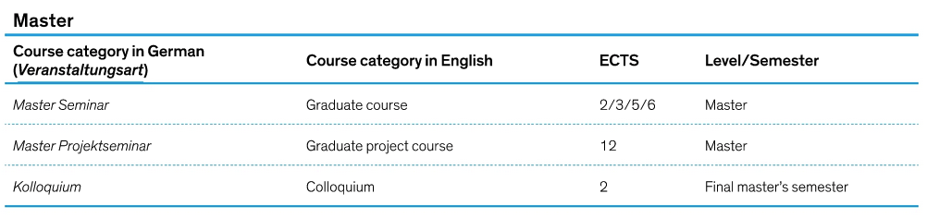
The Department of Sports Science
M.Sc. Programme Sport Science for Health
2-year programme, admission-restricted (15 per year, ) programme taught in English
No practical sports courses on offer – this is a research-oriented M.Sc. Programme preparing students for theory-based work in working field related to health
Project-based work in small groups
Thematic focus areas
  Sport and Health,
  Empirical research methods
  Lab analyses
39

Slide 40
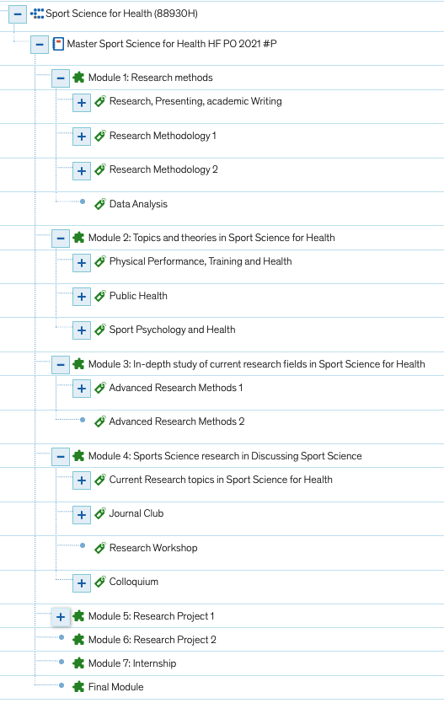

The Department of Sports Science
Contact for exchange students in Sports Science
Dr. Christiana Rosenberg-Ahlhaus
lecturer and student advisor
christiana.rosenberg-ahlhaus@uni-konstanz.de
40

Slide 41
You have questions? You need more information?
Take a look at our website!
https://www.uni-konstanz.de/en/international-office/study-in-konstanz/
and our video: https://youtu.be/FpmBYgqNizg
Contact us!
International.incoming@uni-konstanz.de
erasmus.humanities@uni-konstanz.de
erasmus.polver@uni-konstanz.de (Politics and Public Admin.)
international.wiwi@uni-konstanz (Economics)

Slide 42

Melanie Hochstätter, M.A.
Erasmus+ Coordinators, International Student Advisors
Faculty of Humanities, University of Konstanz
Email: erasmus.humanities@uni-konstanz.de
Notes:
42

